Slide 1

GEM
«Another way of drinking»
Made by: Luca Schäfli
Marc Hochuli
Nico Müller
Notes:
Ein Projekt von: Luca Schäfli
Marc Hochuli
Nico Müller

Slide 2

Content
Timetable
CAD and mechanical components
Schematics and electrical components
Stepper motors
Software
Gem in Action
Conclusion

Slide 3
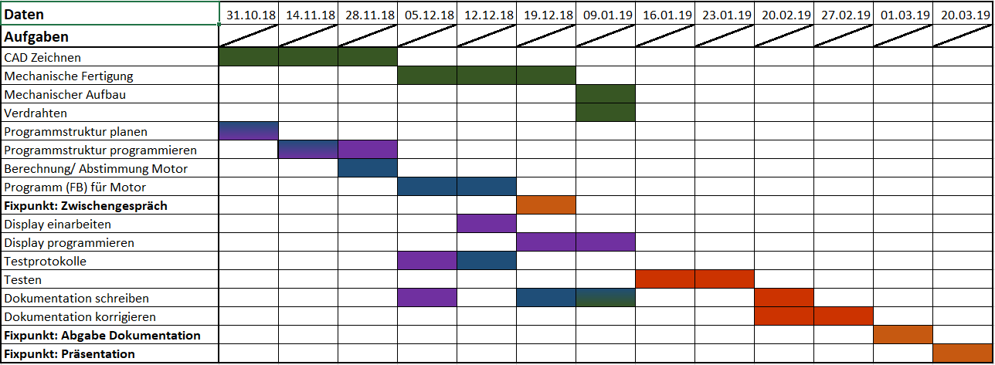
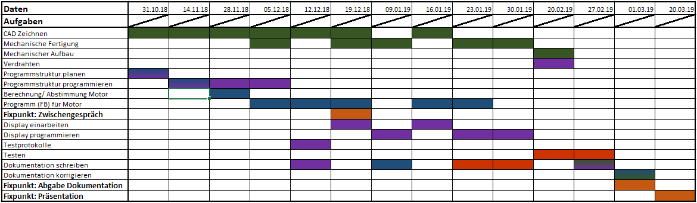
Timetable
Target:
Actual:
Notes:
Acutal:

Slide 4
CAD and mechanical components

Slide 5
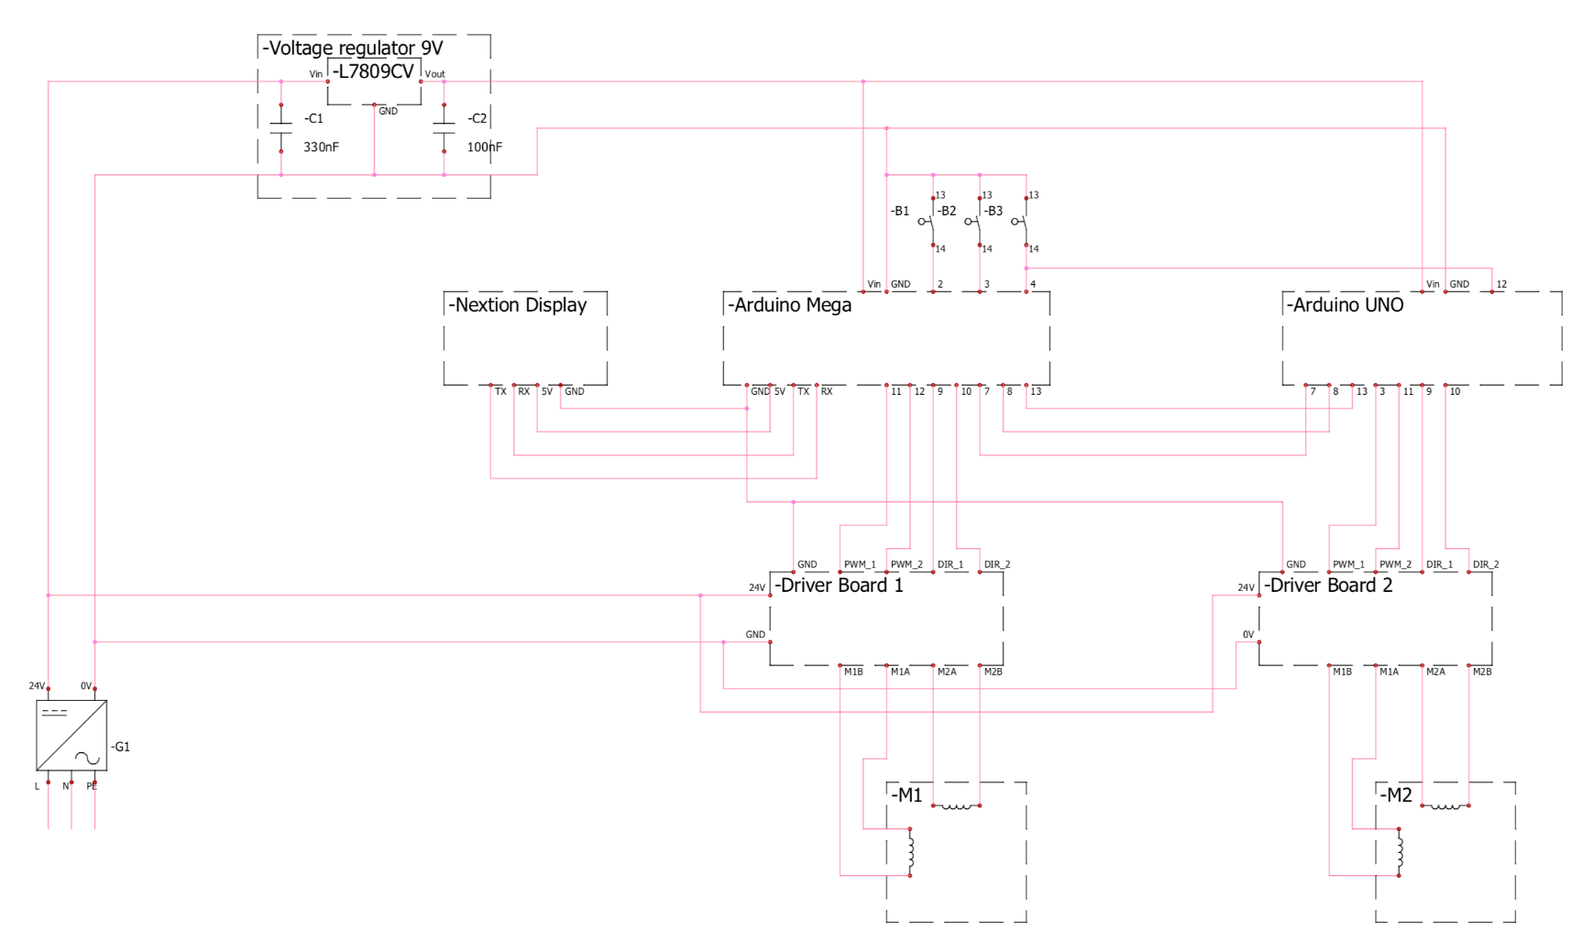
Schematics and electrical components

Slide 6
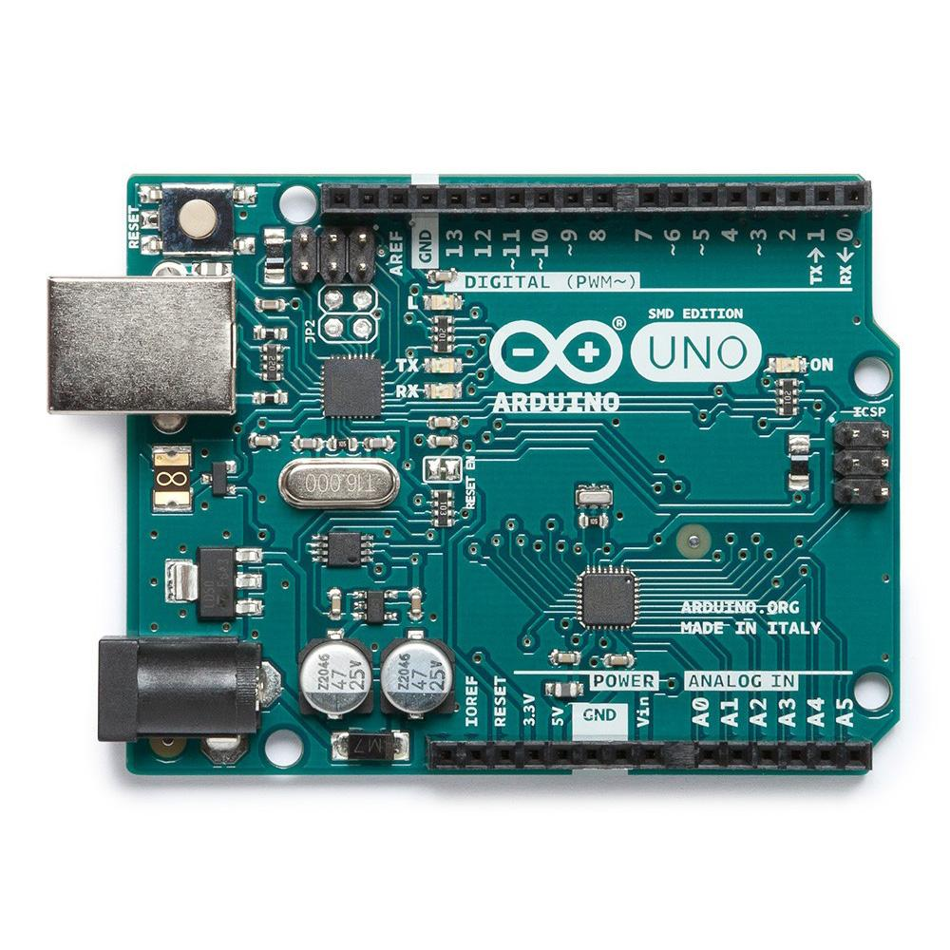
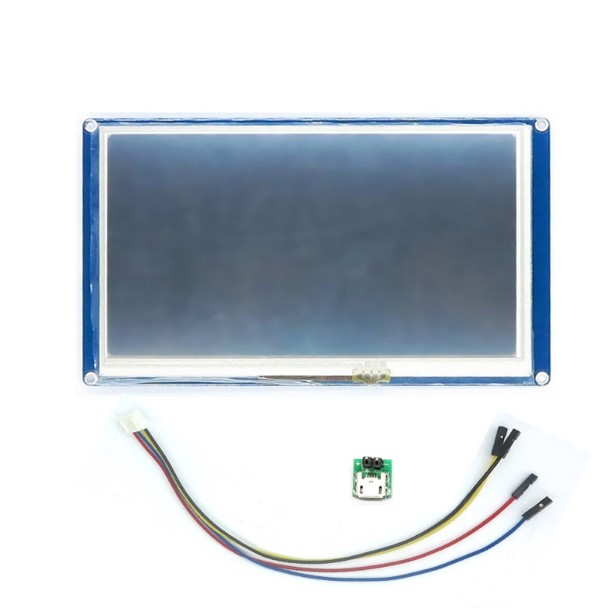
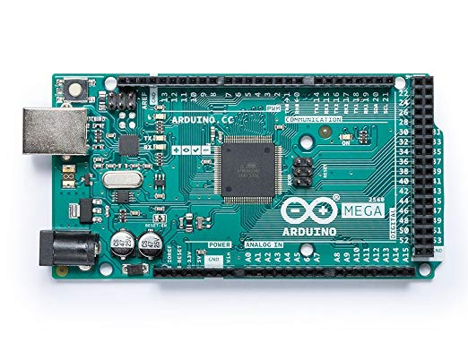
Schematics and electrical components

Slide 7
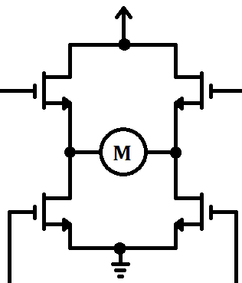
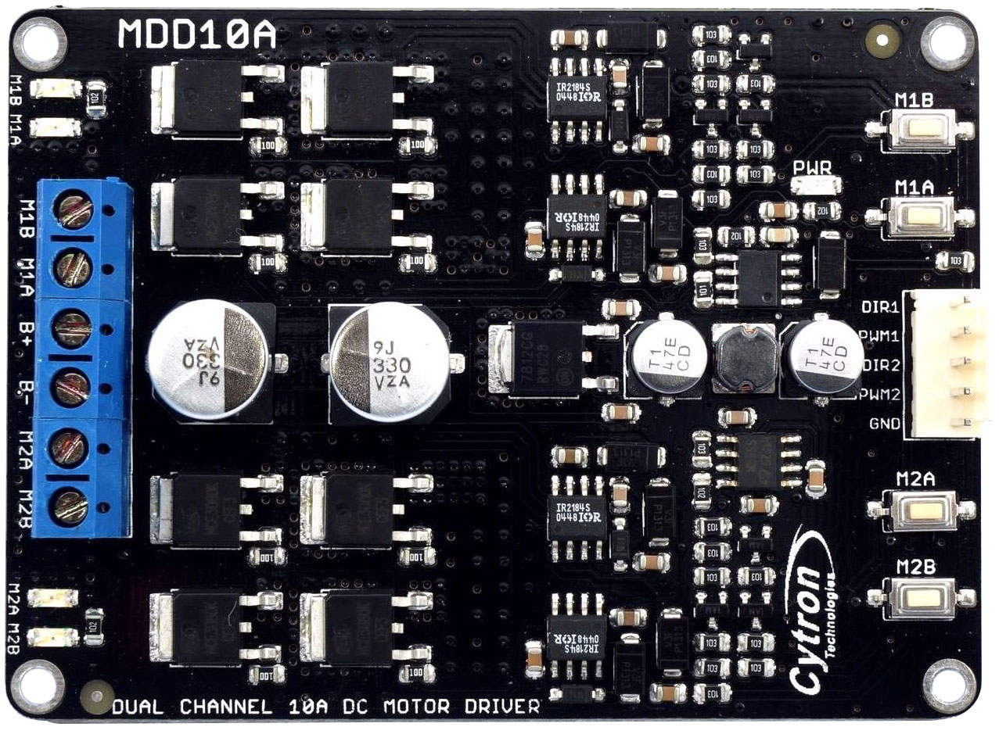
Schematics and electrical components

Slide 8

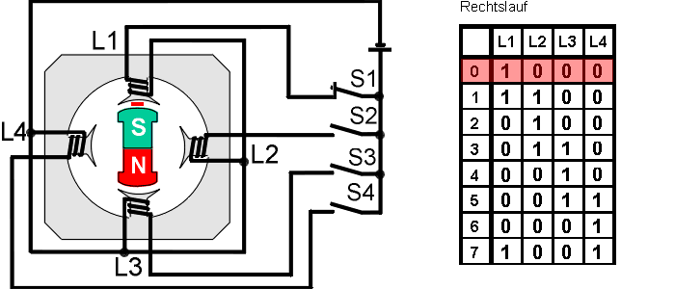
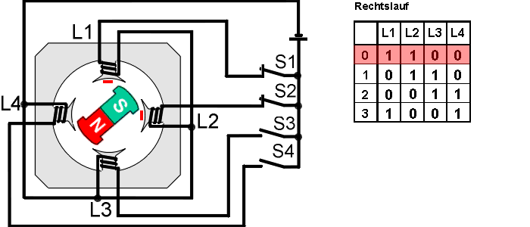
Stepper motors

Slide 9
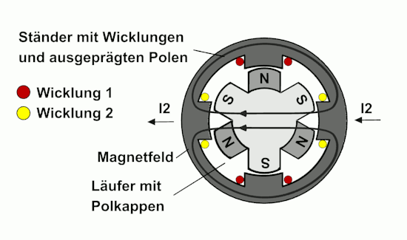
Stepper motors

Slide 10
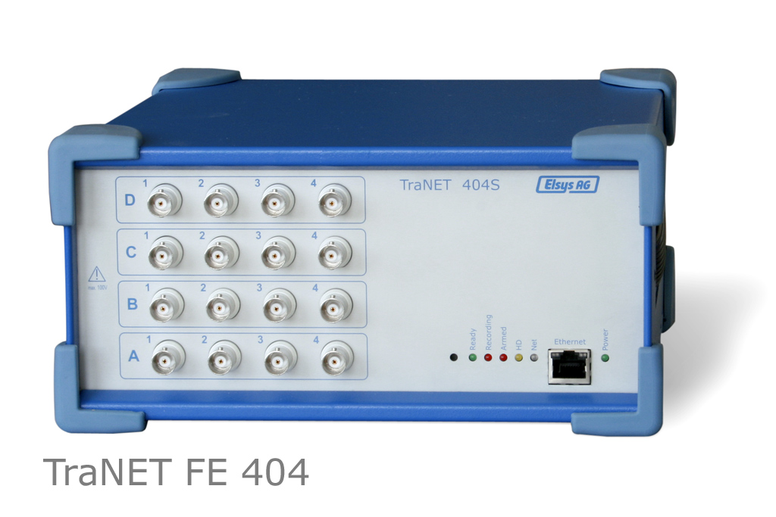
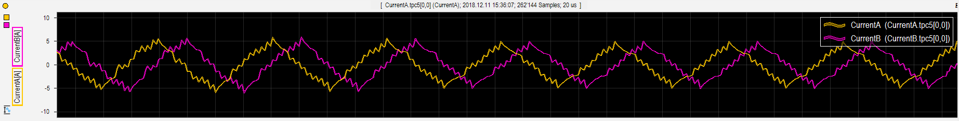
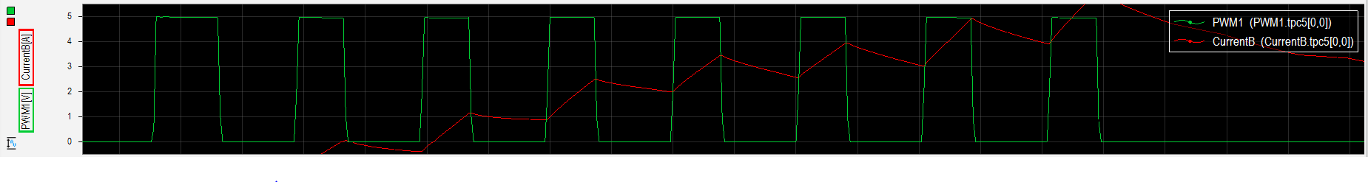
Stepper motors

Slide 11
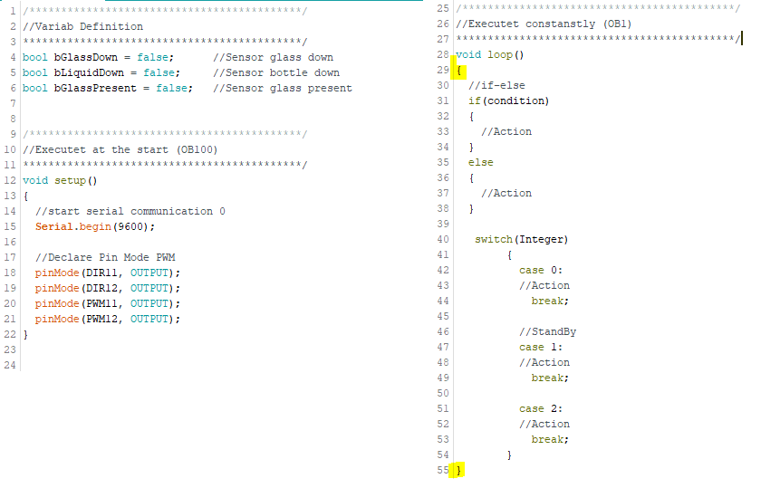
Development Environment
Arduino
Variable definition
Keywords
Void setup
Void loop
Statements
{}

Slide 12
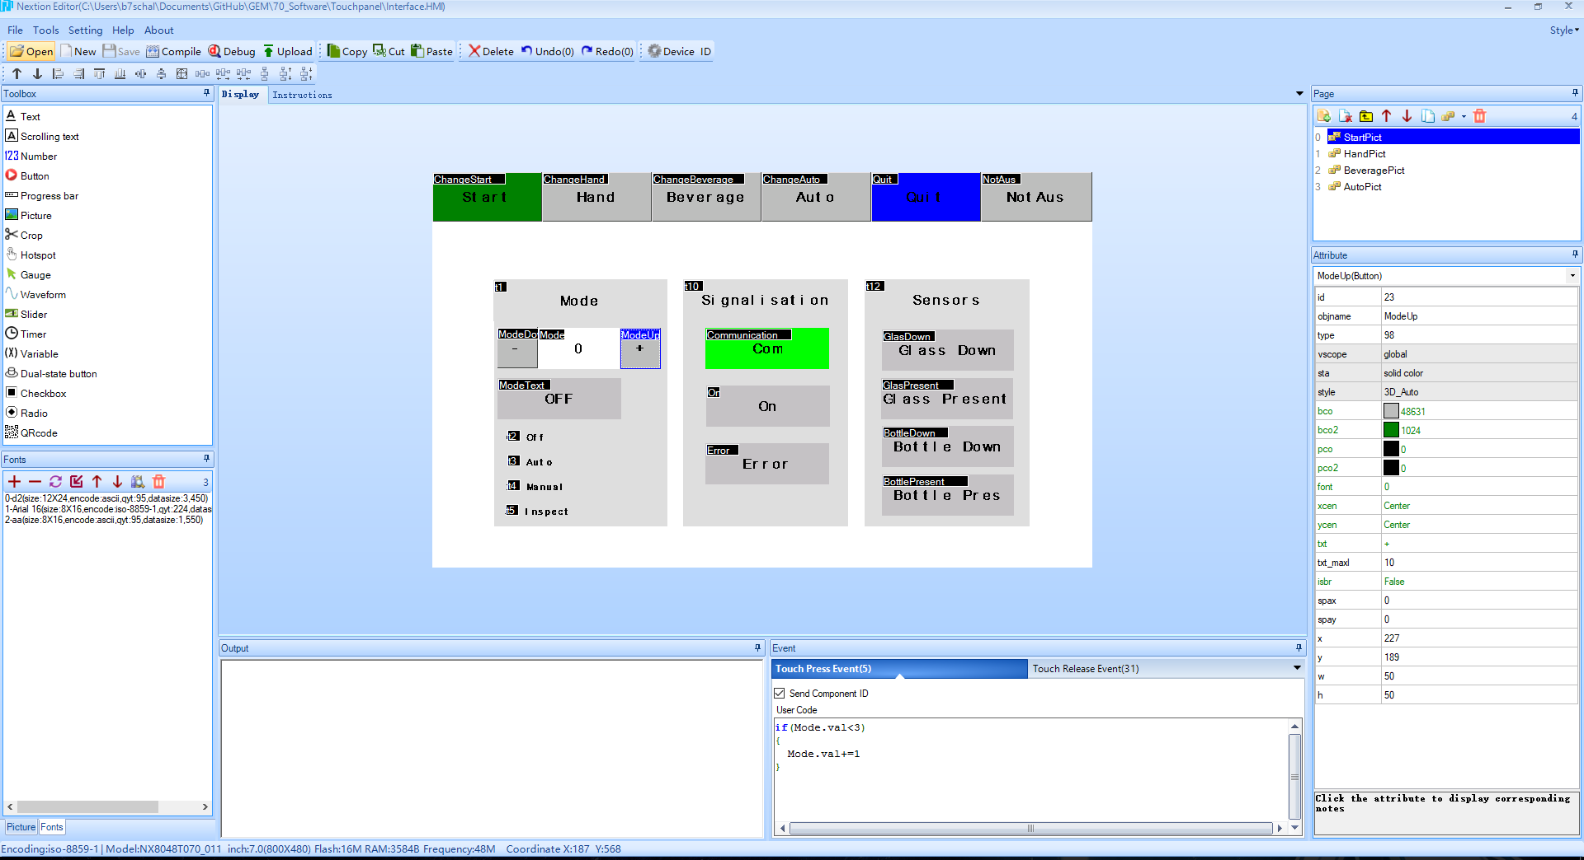
Development Environment
Nextion Editor

Slide 13
Software - Structure
Read Digital Inputs
Read Serial Communication
Update Status
Execute Operating Mode
Movement
Wirte Serial Communication
Write Digital Outputs
Reset HMI Variables

Slide 14
Software - Operating Modes
Operating Mode
Off
Auto
Hand
Insp

Slide 15
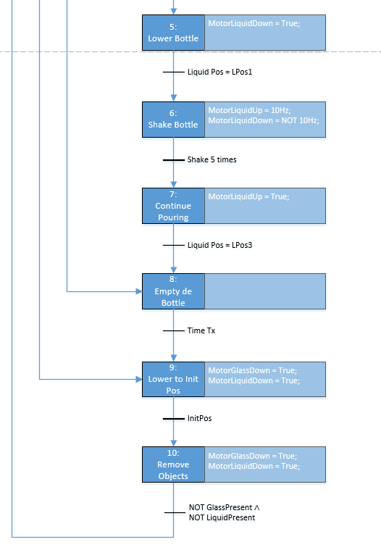
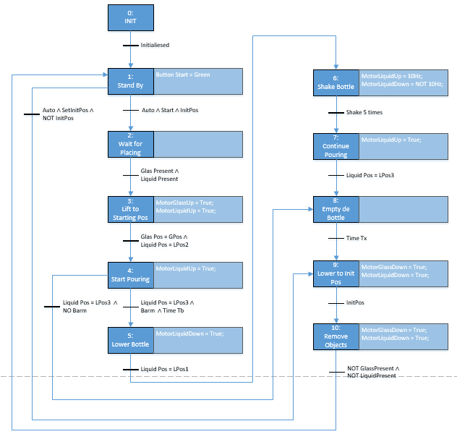
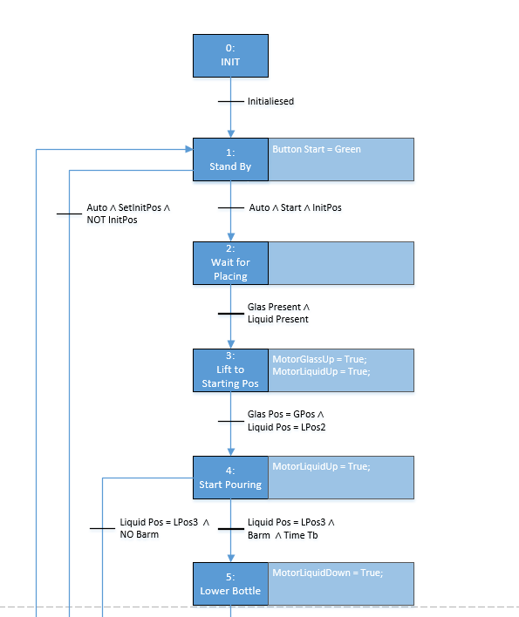
Software – Grafcet

Slide 16
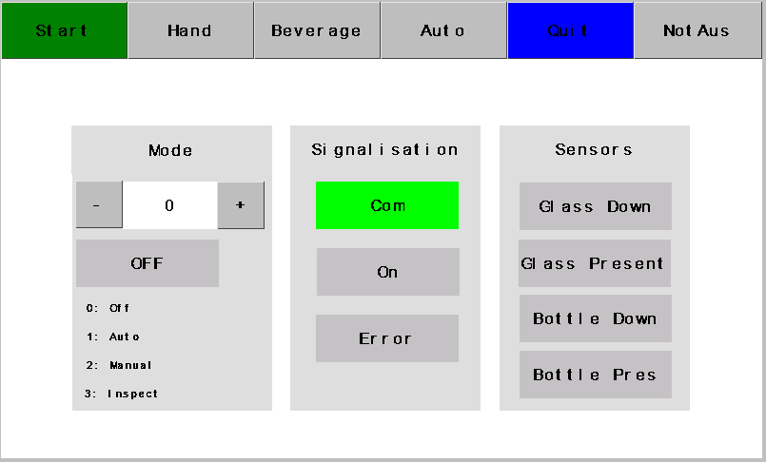
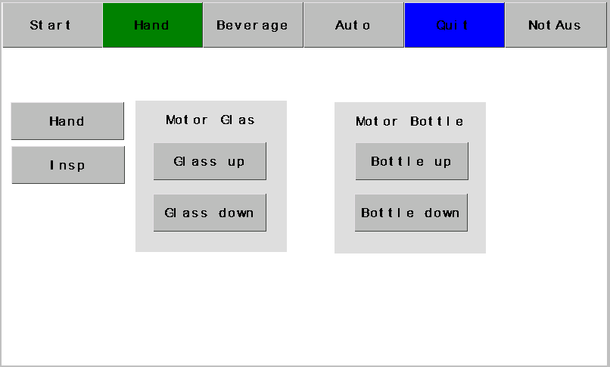
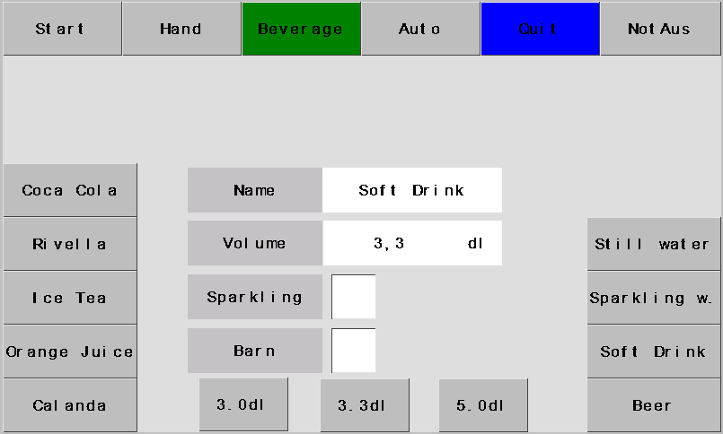
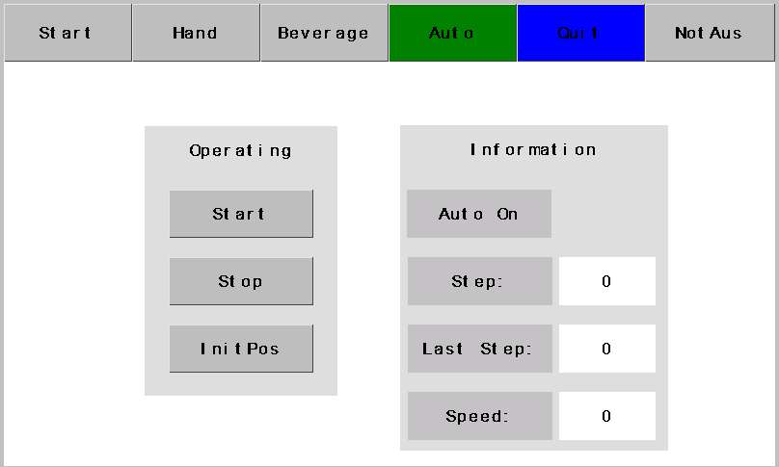
Software - HMI

Slide 17
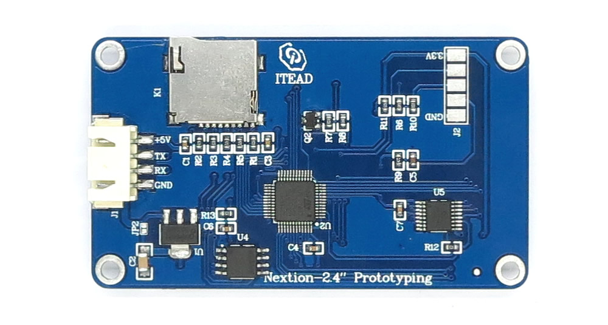
Software - Communication
Arduino Mega Serial Ports
Tx / Rx
Serial Monitor
Serial.println(variable);

Slide 18
Software - Communication
65 02 16 01 FF FF FF
65: Starting Sequence
02: Page number
16: Object ID
01: State of the pushbutton
FF: End Sequence

Slide 19
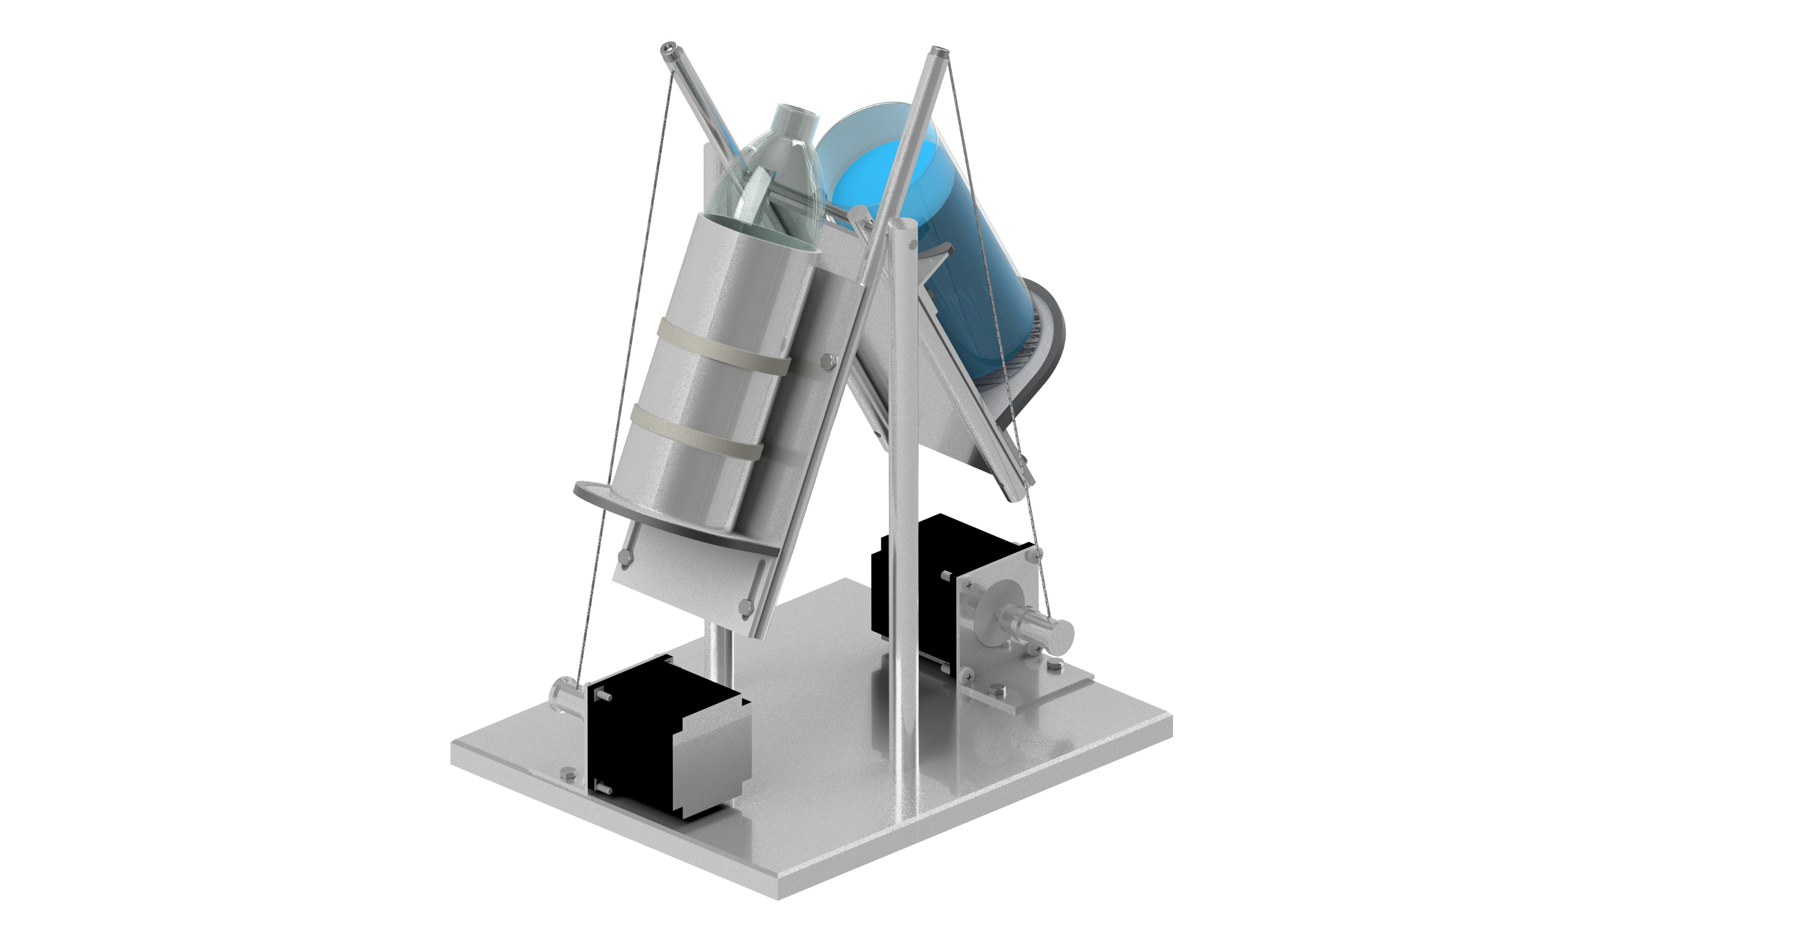
GEM in Action

Slide 20

Conclusion - + / -
+ Achieved our main goals
+ Individuality
+ Research on technical Components
- Minimal signalisation on the Display
- Arduino environment

Slide 21
Conclusion - Improvements
Adjustable speed
Communication
Audibility
Improve adjustable Hight

Slide 22
Abbildungsverzeichnis
Arduino Mega: https://images-na.ssl-images-amazon.com/images/I/71WYcNLIVpL._SX522_.jpg
Nextion HMI: https://cdn.itead.cc/media/catalog/product/i/m/im150416002_3.jpg

